Slide 1
8255 - Programmable Peripheral Interface

Slide 2
The 8255A is a general purpose programmable I/O device designed to transfer the data from I/O to interrupt I/O under certain conditions as required.
It can be used with almost any microprocessor.
It consists of three 8-bit bidirectional I/O ports (24I/O lines) which can be configured as per the requirement.

Slide 3
Ports of 8255A
8255A has three ports, i.e., PORT A, PORT B, and PORT C.
Port A contains one 8-bit output latch/buffer and one 8-bit input buffer.
Port B is similar to PORT A.
Port C can be split into two parts, i.e. PORT C lower (PC0-PC3) and PORT C upper (PC7-PC4) by the control word.

Slide 4
These three ports are further divided into two groups, i.e. Group A includes PORT A and upper PORT C.
Group B includes PORT B and lower PORT C. These two groups can be programmed in three different modes, i.e.
the first mode is named as mode 0,
the second mode is named as Mode 1
and the third mode is named as Mode 2.

Slide 5
Operating Modes
Mode 0 − In this mode, Port A and B is used as two 8-bit ports and Port C as two 4-bit ports. Each port can be programmed in either input mode or output mode where outputs are latched and inputs are not latched. Ports do not have interrupt capability.

Slide 6
Mode 1 − In this mode, Port A and B is used as 8-bit I/O ports. They can be configured as either input or output ports. Each port uses three lines from port C as handshake signals. Inputs and outputs are latched.

Slide 7
Mode 2 − In this mode, Port A can be configured as the bidirectional port and Port B either in Mode 0 or Mode 1. Port A uses five signals from Port C as handshake signals for data transfer. The remaining three signals from Port C can be used either as simple I/O or as handshake for port B.

Slide 8
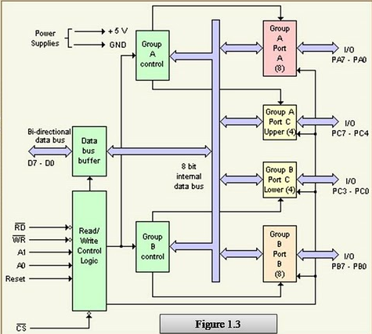

Slide 9
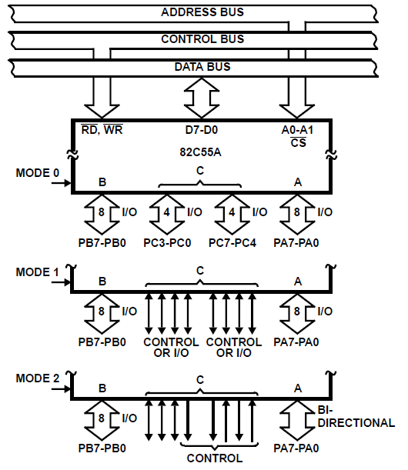

Slide 10
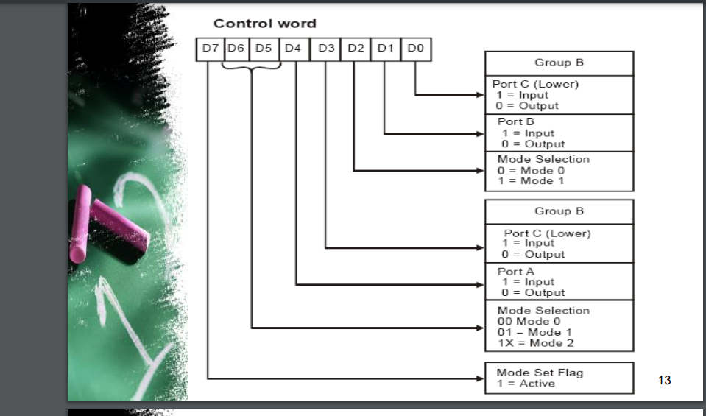

Slide 11
Mode 1 Input Control Signals
STB (Strobe Input) : This is an active low input signal for 8255 Programming and Operation and output signal for the input device. The input device activates this signal to indicate CPU that the data to be read is already sent on the port lines of 8255 port. Upon activation of this signal 8255 loads the data from the input port lines into the input buffer of that port.

Slide 12
IBF (Input Buffer Full) : This is an active high output signal for 8255 and an input signal for input device. This signal is generated by 8255 Programming and Operation in response to STB signal as an acknowledgment to input device. It also indicates to the input device that the input buffer is full and it is not ready to accept next byte from the input device. Therefore input device sends data on the port lines only when IBF signal is not active. The IBF signal is deactivated when CPU reads the data from input buffer of the respective port by activation of RD signal.

Slide 13
INTR (Interrupt Request) : This is an active high output signal generated by 8255. A ‘high’ on this output can be used to interrupt the CPU when an input device is requesting service. The 8255 Programming and Operation sets the INTR when STB signal is ‘one’, IBF signal is ‘one’ and INTE is ‘one’, indicating CPU that the data from the input device is available in the input buffer. This signal is reset by the falling edge of the RD signal i.e. immediately after reading the data from the input buffer

Slide 14
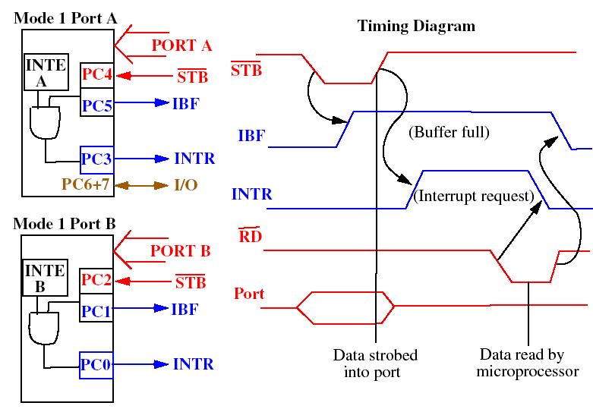
Mode 1 (strobed input)Operation

Slide 15
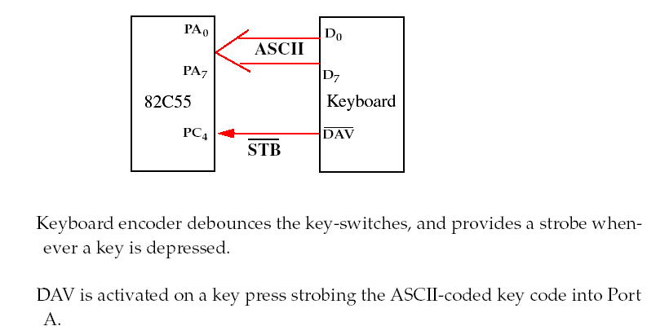
BIT5 DB 20H
READ PROC
UP: IN AL,PORTC
TEST AL,BIT5
JZ UP
IN AL,PORTA
RET
READ ENDP

Slide 16
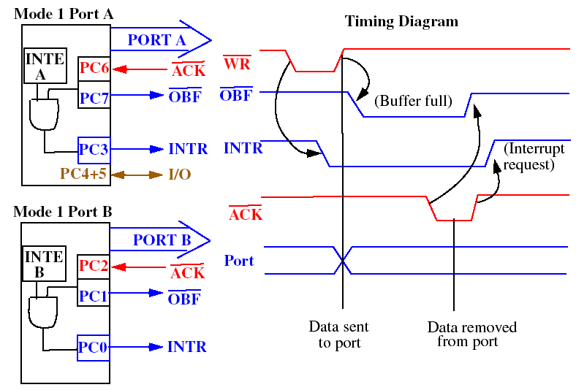
Mode 1 (strobed output)Operation

Slide 17
Mode 1 : Output control signals:
OBF (Output Buffer Full) :
This is an active low output signal for 8255 Programming and Operation and input signal for the output device. The 8255 activates this signal to indicate output device that data is available on the output port. Upon activation of OBF signal, output device reads data from the output port and acknowledges it by ACK signal. The OBF signal is activated at the rising edge of the WR signal and de-activated at the falling edge of the ACK signal.

Slide 18
ACK (Acknowledge Input):
This is an active low input signal for 8255 and output signal for the output device. The output device generates this signal to indicate 8255 that the data from port A or Port B has been accepted.

Slide 19
INTR (Interrupt Request) :
This is an active high output signal generated by 8255 A ‘high’ on this output can be used to interrupt the CPU when an output device has accepted data transmitted by the CPU. The 8255 Programming and Operation sets the INTR when ACK signal is ‘one’, OBF is ‘one’ and INTE is ‘one, indicating that the output device is ready to accept next data byte. This signal is reset by the falling edge of the WR signal i.e. immediately after sending the data to the output port.

Slide 20
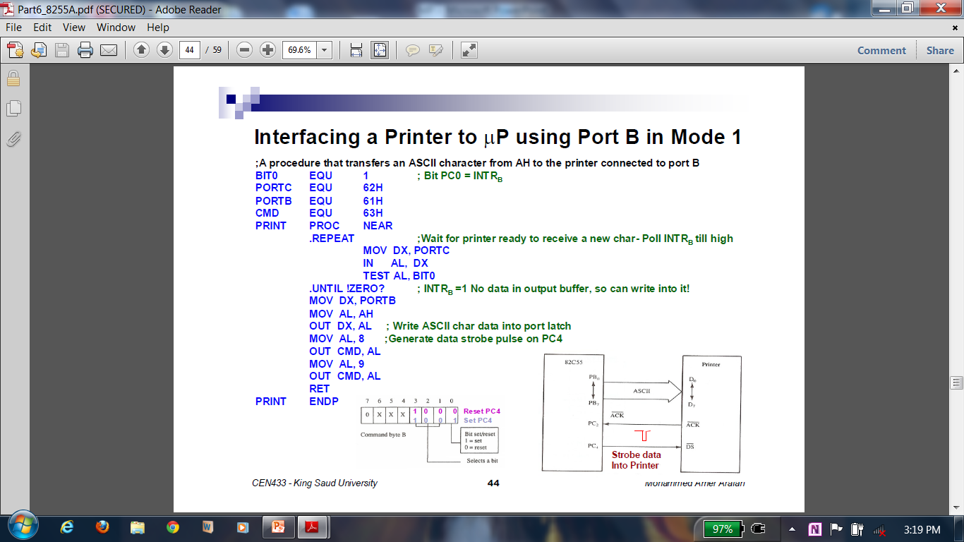
BIT1 DB 2
PRINT PROC
UP: IN AL,PORTC
TEST AL,BIT1
JZ UP
MOV AL,AH
OUT PORTB,AL
MOV AL,8
OUT CMD, AL
MOV AL,9
OUT CMD,AL
RET
PRINT ENDP

Slide 21
Programming in Mode 2 (Strobes Bi-directional Bus I/O):
When the 8255 Programming and Operation is operated in Mode 2 (by loading the appropriate control word), Port A can be used as a bi-directional 8-bit I/O bus using for handshaking.
Port B can be programmed in Mode 0 or in Mode 1. When Port B is programmed in mode 1, PC₀ – PC₂ lines of Port C are used as handshaking signals.

Slide 22
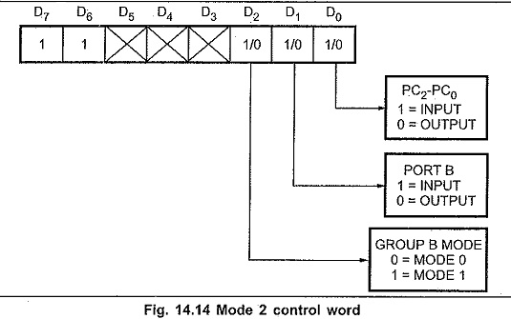

Slide 23
Mode 2 : Control signals:
INTR (Interrupt Request).: A ‘high’ on this output can be used to interrupt the CPU for input or output operations.
OBF_{A} (Output Buffer Full):
This is an active low output which indicates that the CPU has written data into Port A.

Slide 24
ACK_{A} (Acknowledge):
This is an active low input signal (generated by the peripheral) which enables the tri-state output buffer of Port A and makes Port A data available to the peripheral. In Mode 2, Port A outputs are in tri-state until enabled.
INTE 1:
This is the flip-flop associated with Output Buffer Full. INTE 1 can be used to enable or disable the interrupt by setting or resetting PC₆ in the BSR Mode.

Slide 25
Input Control Signals:
STB (Strobe Input):
This is an active low input signal which enables Port A to latch the data available at its input.
IBF (Input Buffer Full Flip-Flop):
This is an active high output which indicates that data has been loaded into the input latch of Port A.
NTE 2:
This is an Interrupt enable flip-flop associated with Input Buffer Full. It can be controlled by setting or resetting PC₄ in the BSR Mode.

Slide 26
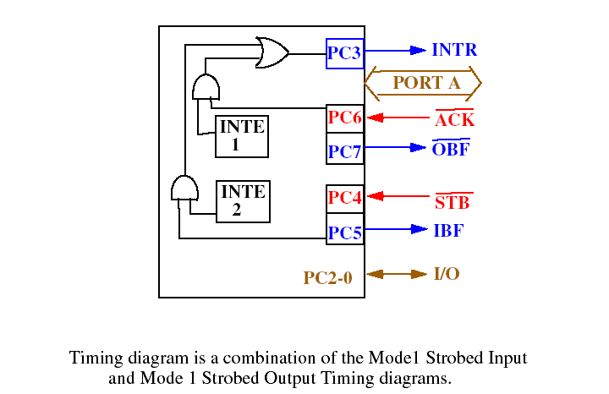
Mode 2 –Bi-directional Operation

Slide 27
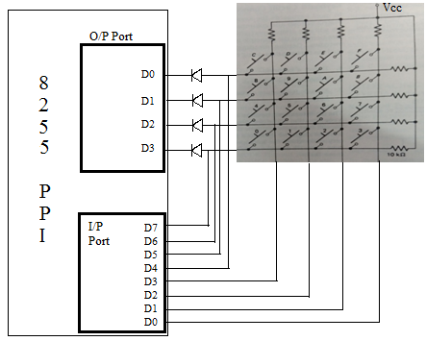
4x4 matrix keyboard

Slide 28
3x8 Key Matrix interfaced to 8255 mode 0
KEYSCAN PROC
KEYSCAN1: MOV AL,90h
MOV DX,CMD
OUT DX, AL
MOV BH,00000100B
MOV AH,10H
MOV CX,03 ; rows
UP: MOV AL,BH
OUT PORTB,AL
IN AL,PORTA
CMP AL,0
JNZ GETKEYCODE
SHR BH,1
SUB AH,08
LOOP UP
JMP KEYSCAN1
GETKEYCODE: RCR AL,1
JC EXIT1
ADD AH,01
JMP GETKEYCODE
EXIT1: MOV AL,AH
RET
KEYSCAN ENDP

